Slide 1
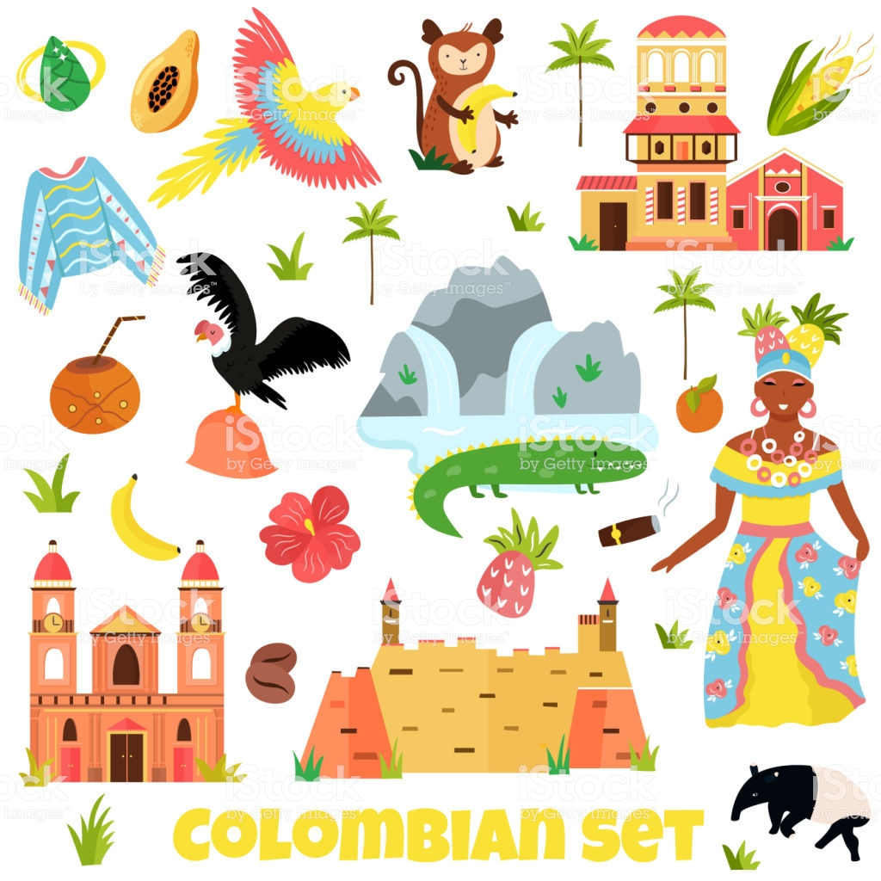

Slide 2
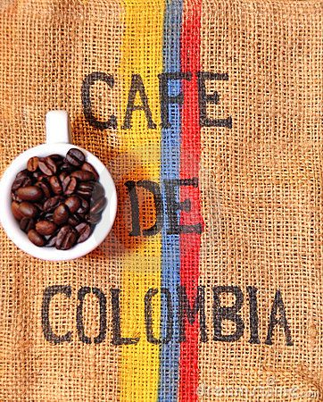
This coffee is from Colombia. People drink coffee from Colombia in cafes all around the world. Colombia coffee is one of the most famous and one of the most delicious. It takes 45 coffee beans to make one small cup of coffee.

Slide 3
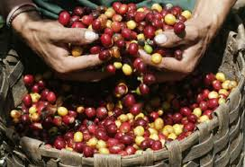
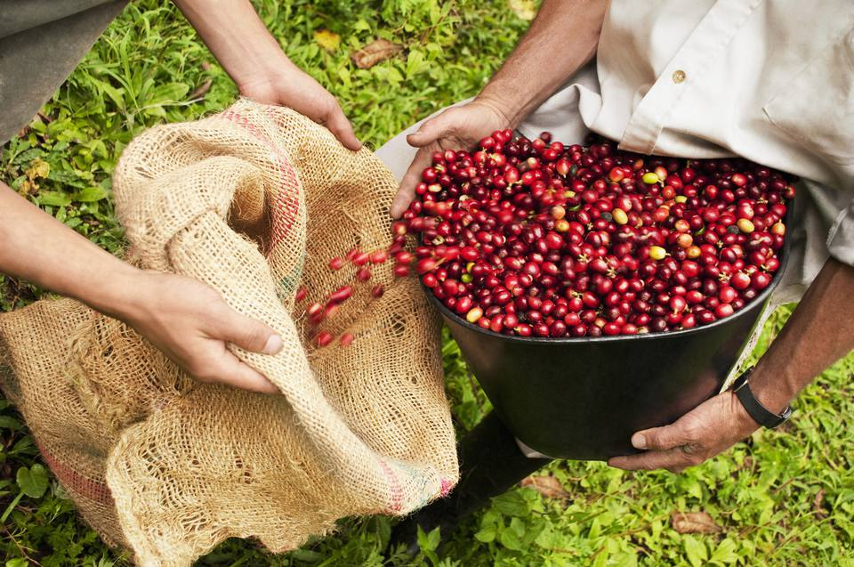
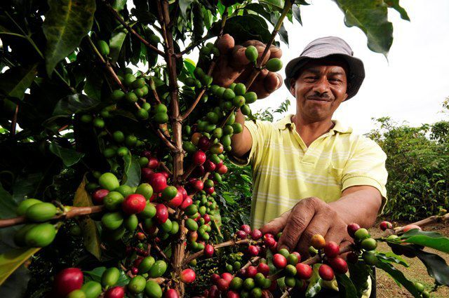
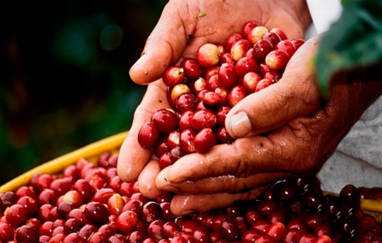
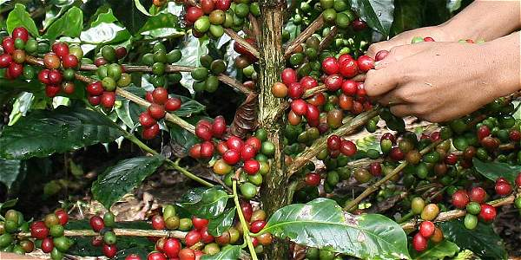
Producing Coffee
All coffee comes from coffee beans. The beans grow on small plants in hot, sunny countries. First, farmers pick the coffee beans. Then, they wash them and put them in water. Next, they put the beans in the sun for five days.

Slide 4
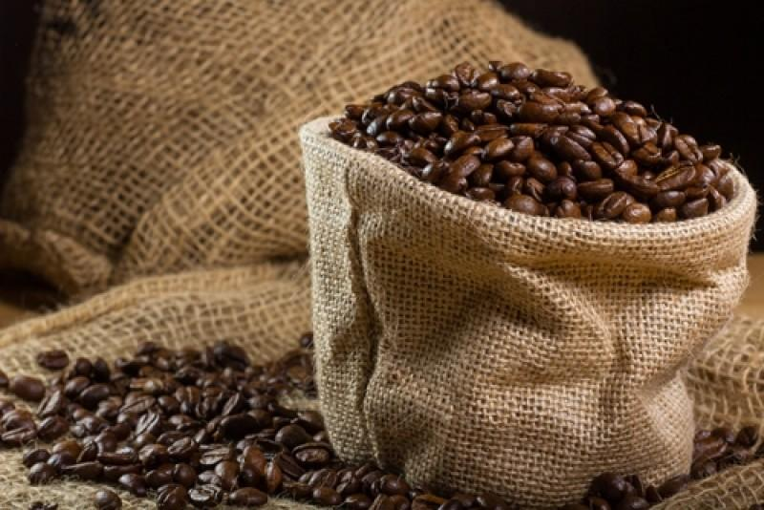
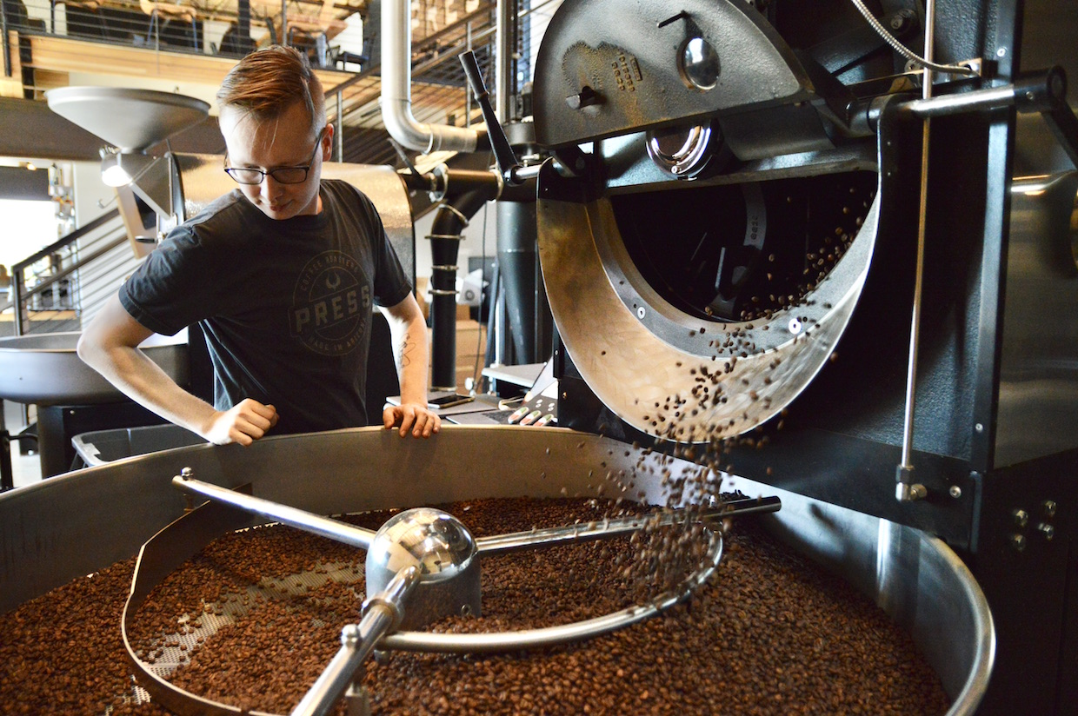
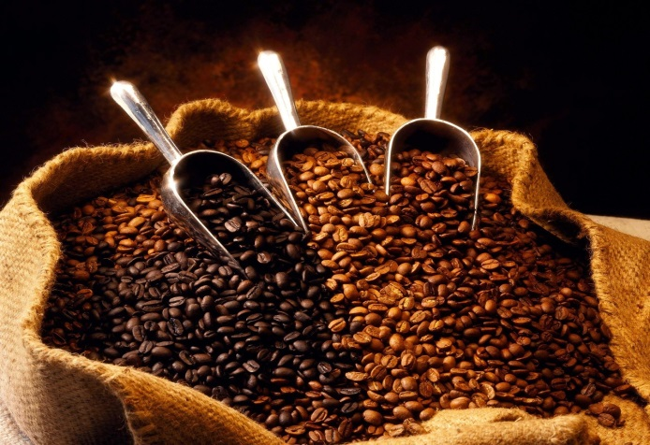
After that, the farmers clean the beans again and roasted them. Then, they pack the beans in bags ready to sell all around the world. So next time you see someone drinking a cup of coffee, maybe it’s from Colombia!

Slide 5
